Slide 1
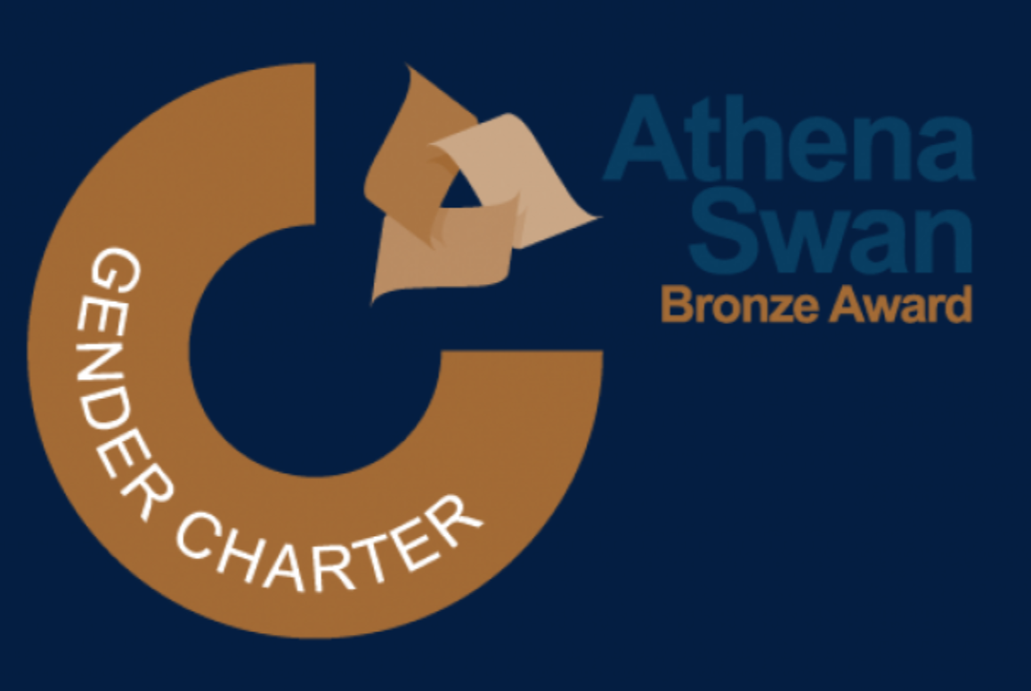
The Automobile Moment: Why Higher Education Must Outrun the 'Horse-Carriage’ Pedagogy
School of Computing
Pervasive Computing Research Centre (PCRC)
Dr Rashid Kamal
07/05/2026

Slide 2
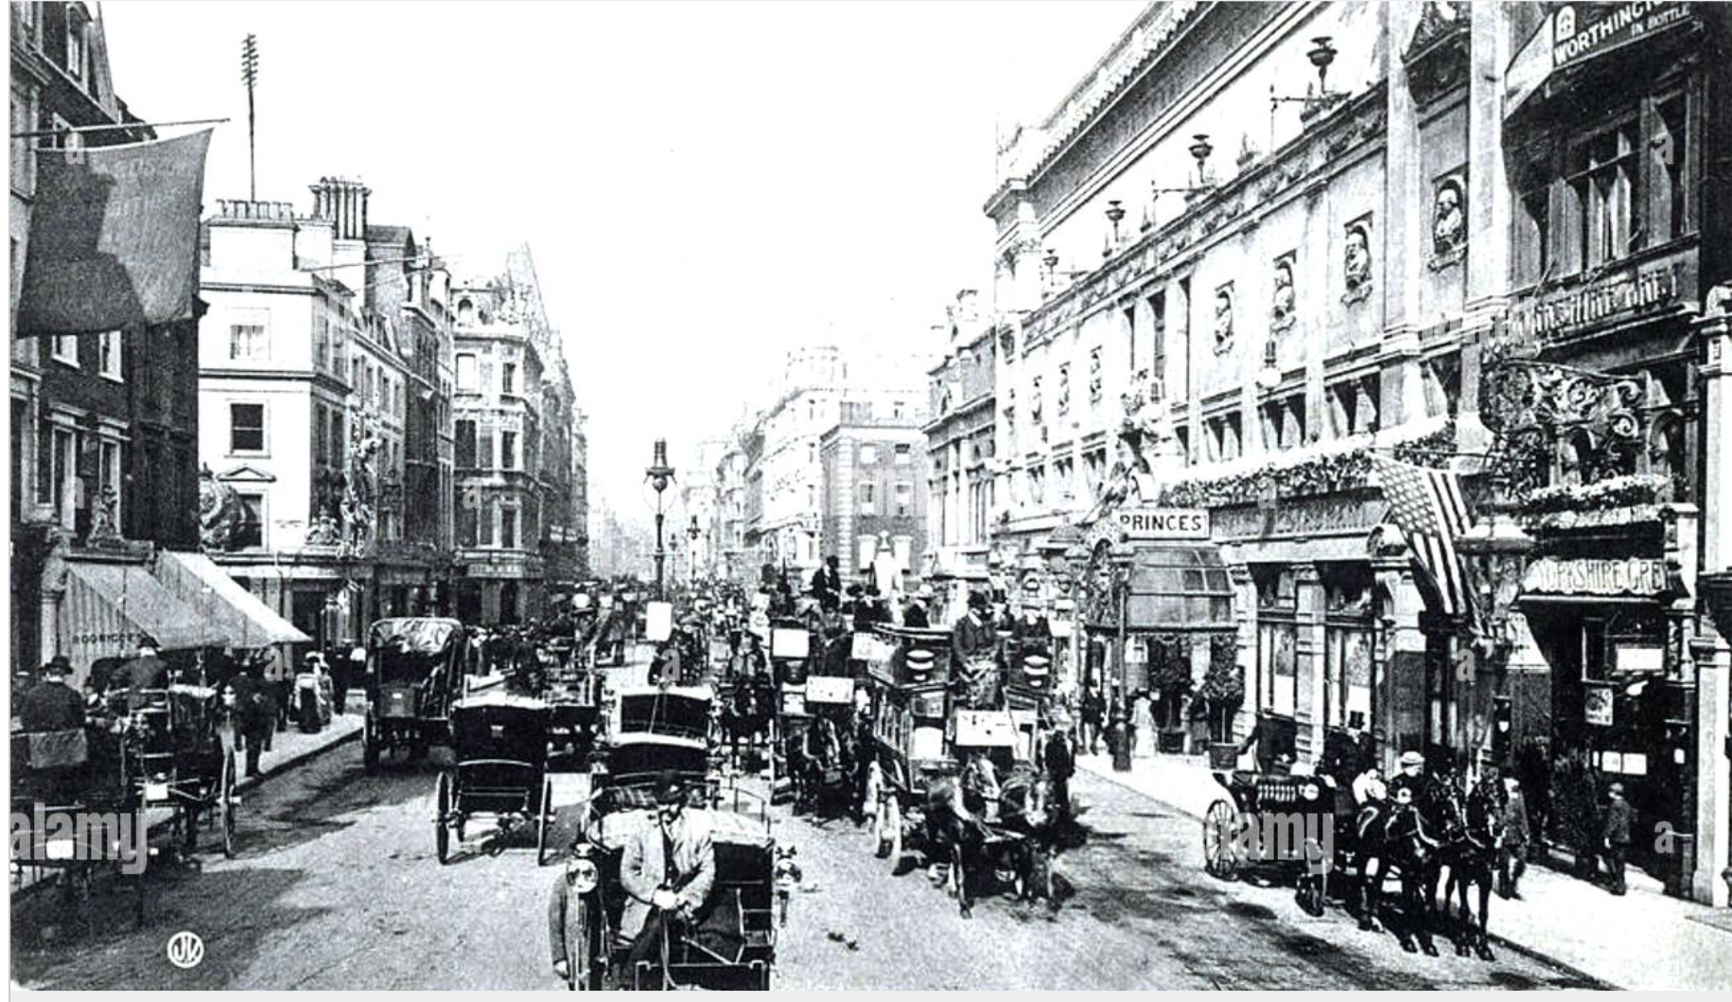
Notes:
https://www.alamy.com/regent-street-london-early-1900s-image244012660.html

Slide 3

Notes:
https://www.alamy.com/regent-street-london-early-1900s-image244012660.html

Slide 4

Notes:
https://www.businessinsider.com/vintage-photos-london-century-ago-2020-7#likewise-oxford-street-hasnt-changed-much-except-for-the-types-of-cars-and-buses-that-fill-the-street-3

Slide 5
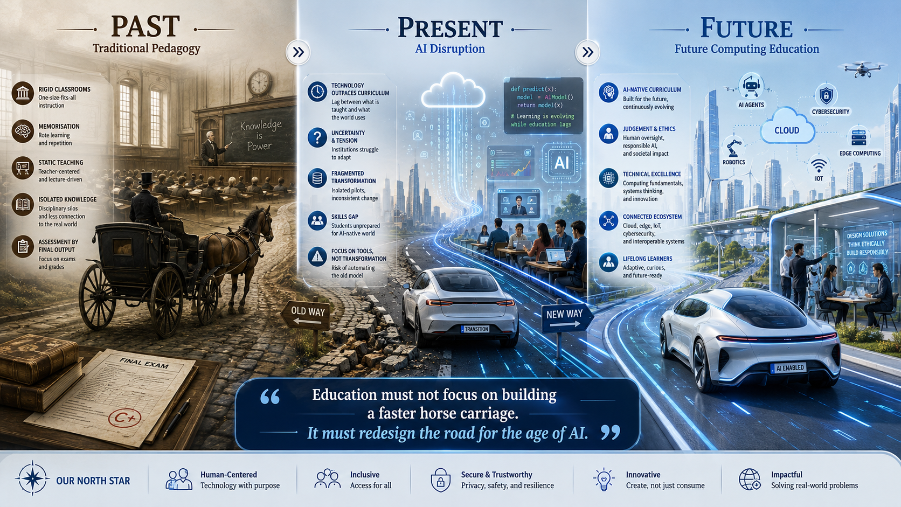
Notes:
This is the journey I want to frame today. The past is not useless, but it was built for a different road. The present is disruptive because AI has changed how students write, code, and solve problems. The future must be AI native, technically deeper, and centred on judgement.

Slide 6
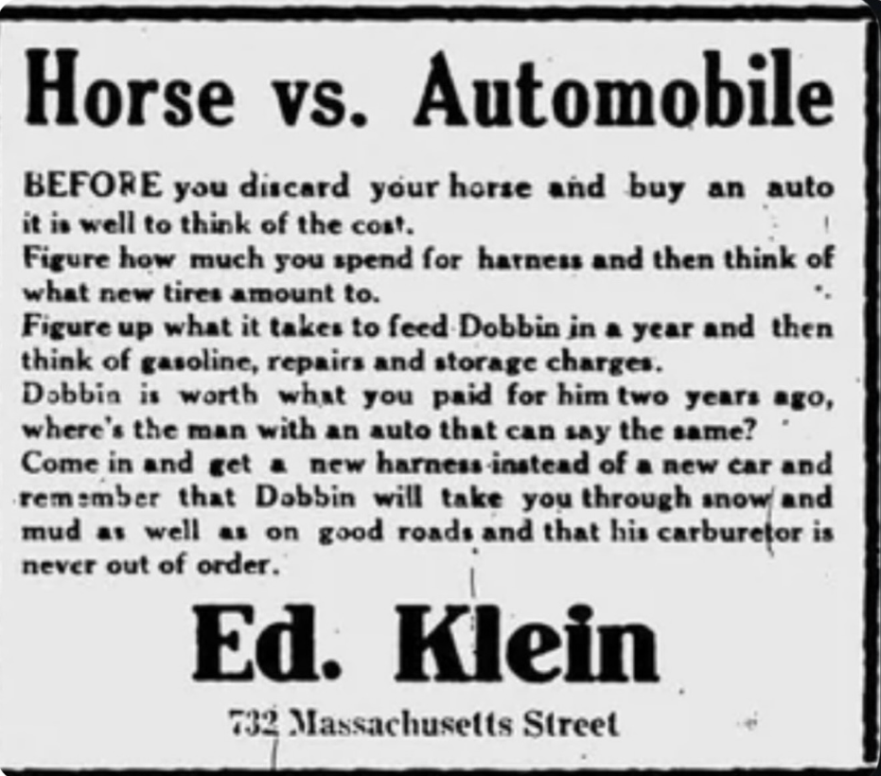

Slide 7
The Central Question: What Are We Actually Preparing Students For?
A world where AI writes code.
A world where software becomes agentic.
A world where cybersecurity risks are AI amplified.
A world where data, cloud, edge, and automation define work.
A world where judgement matters more than memorisation.

Slide 8
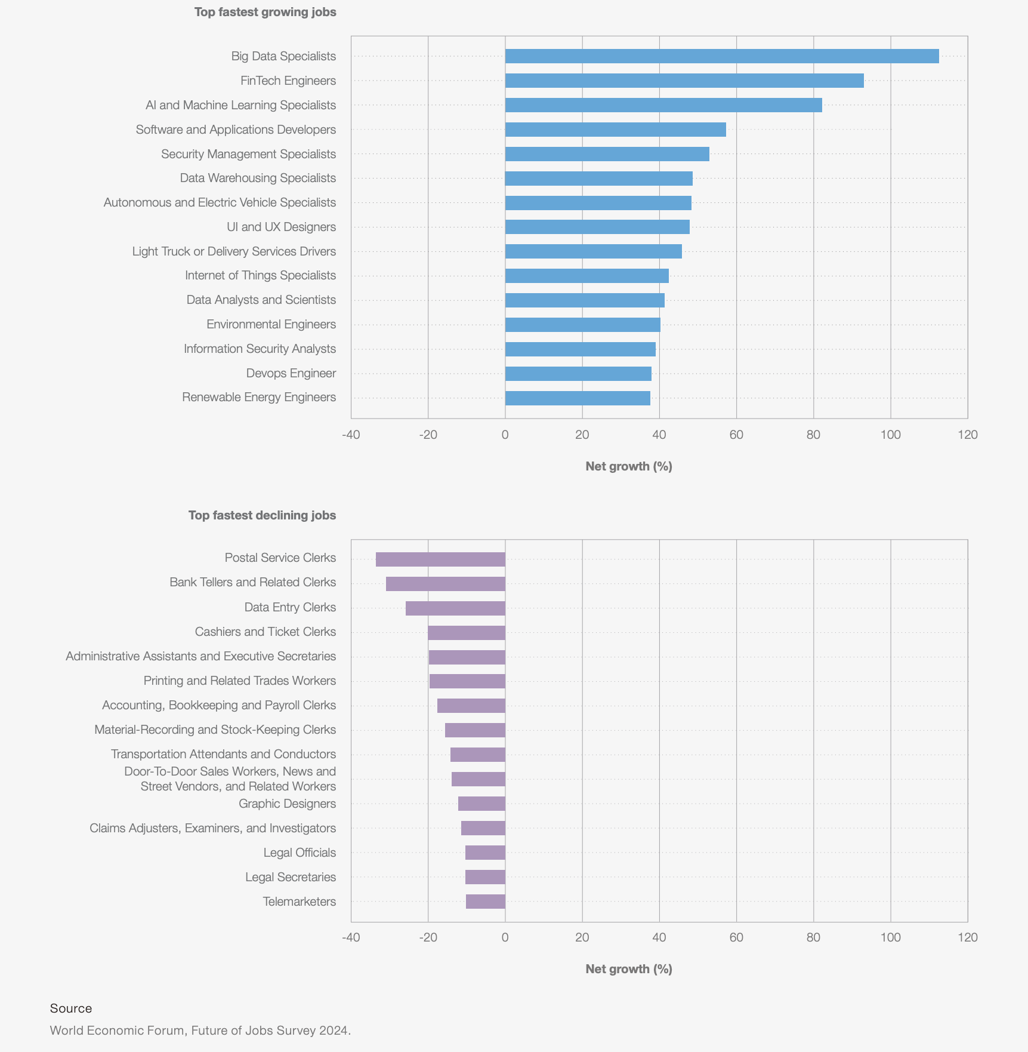
The Labour Market Has Already Moved
AI and big data are among the fastest growing skill areas.
Networks, cybersecurity, and technological literacy are increasingly important.
Employers report major skill change toward 2030.
Human capabilities such as analytical thinking, creativity, resilience, and lifelong learning remain critical.
Fastest growing jobs are AI, data, software, cyber, IoT, and DevOps driven.
Graduate value is shifting from task completion to technical judgement.
Curriculum must move from isolated coding tasks to integrated system capability.
Fig 1: Fastest growing and declining jobs by projected net growth, showing the shift toward data, AI, software, cybersecurity, and technology focused roles. Source: World Economic Forum, Future of Jobs Survey 2024
Notes:
The fastest growing jobs are not asking for isolated coding skills. They require integrated computing capability across AI, data, software, security, cloud, and connected systems.
This figure is important because it shows that the growth areas are not narrow computing roles. They sit across AI, data, software, cybersecurity, IoT, and DevOps. That means our curriculum cannot remain a collection of isolated topics. It has to prepare students to work across connected technical systems.

Slide 9
The Higher Education Wake Up Call
Traditional degree structures are too slow for technological change
Disciplinary silos do not match real world problems
Students need lifelong, modular, and adaptive learning
Universities must create capability, not just credentials

Slide 10
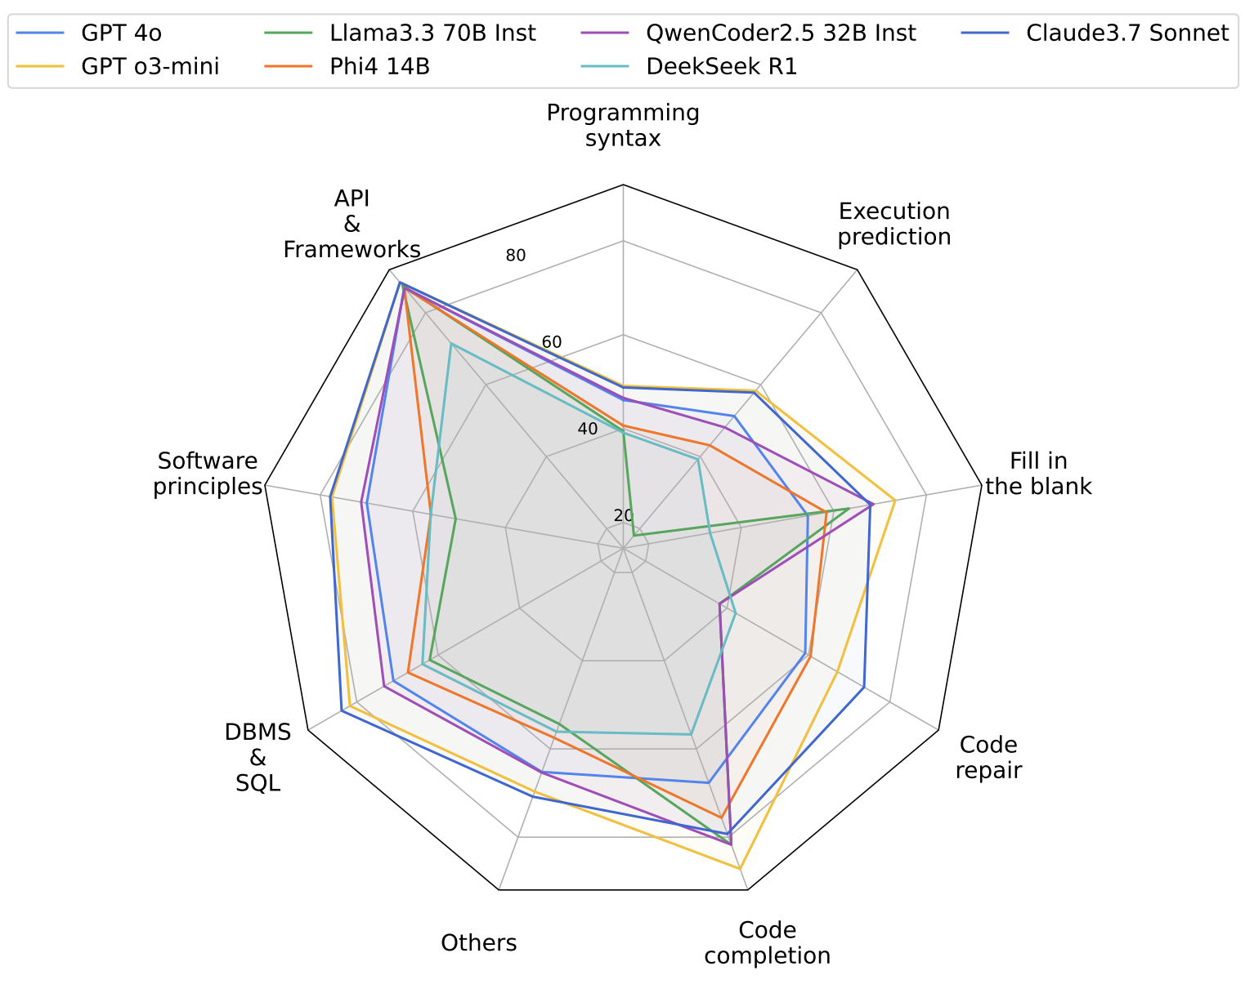
AI Capability Is Moving Faster Than Curriculum Revision
AI capability in coding, reasoning, and content generation is improving rapidly
Curriculum review and approval cycles in universities are much slower
Traditional assessments are becoming misaligned with real world digital practice
Higher education must redesign learning for a world where AI is already part of computing work
Fig 2: AI capabilities in code understanding and reasoning are advancing rapidly, highlighting the growing gap between emerging AI performance and the slower pace of curriculum revision. Adapted from Nguyen Manh et al. (2025), CodeMMLU, ICLR 2025.

Slide 11

The Classroom Myth
AI use will not disappear
Bans often push use underground
Detection tools cannot carry the full burden
Students need AI literacy, not AI avoidance
Responsible AI use must be taught, evidenced, and assessed

Slide 12
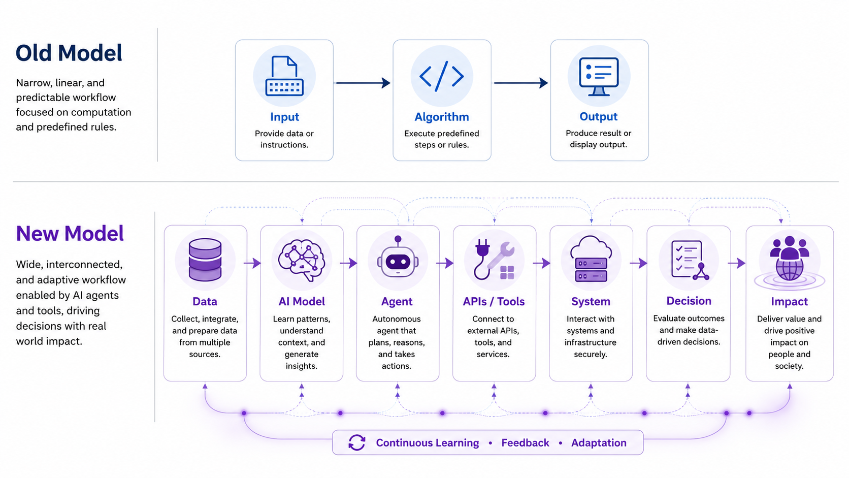
From Programs to Intelligent Systems
Computing is moving from isolated programs to intelligent, connected systems
Students must understand software, data, AI, infrastructure, and users together
The future graduate designs, verifies, secures, and governs intelligent systems
Fig 3: From deterministic computation to agentic AI systems with real world impact (Generated from Gemini/ChatGPT
Notes:
In the past, we often taught computing as input, algorithm, and output. That still matters, but the real world is now much more complex. Modern systems include data pipelines, AI models, autonomous agents, APIs, cloud services, and human decision making.

Slide 13
From Software Tools to Software Agents
Agentic systems can plan, call tools, write code, and use memory
They can interact with APIs, databases, cloud services, and external systems
Failures may be unpredictable, hidden, or difficult to trace
Students need orchestration, guardrails, monitoring, and human oversight
Traditional software tools | Agentic software systems
Wait for user input | Act toward a goal
Follow fixed instructions | Plan multi step tasks
Produce bounded outputs | Call APIs and tools
Easy to trace | Harder to predict
User controls each step | Human oversight is needed
Notes:
The future software engineer will not only write code. They will increasingly supervise intelligent systems that can act, call tools, and make partial decisions. That requires a different type of technical education.

Slide 14
Code Generation Does Not Equal Code Understanding
A model may generate working code without deeply understanding it
Passing test cases does not always prove reasoning or comprehension
Code understanding requires debugging, execution prediction, and failure analysis
Student assessment must move from “produce code” to “explain, verify, and defend code”

Slide 15
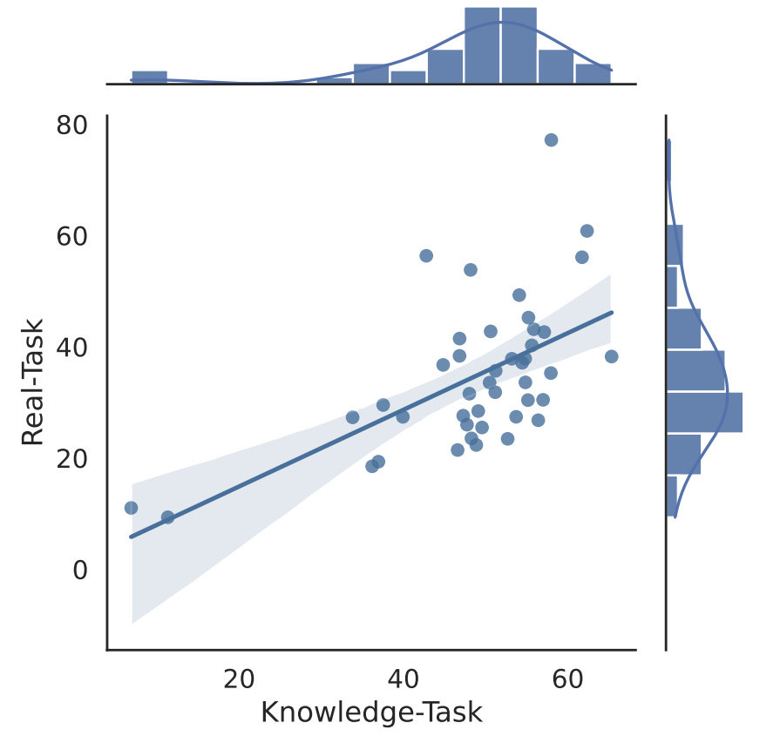
Fundamentals Still Matter in the AI Age
Software knowledge is linked with real world coding performance
AI does not remove the need for programming foundations
The challenge is to assess how students apply, verify, and defend those foundations
Fig 5: Relationship between software knowledge tasks and fundamental coding skill tasks, showing that stronger foundational understanding is associated with better real world programming performance. Adapted from Nguyen Manh et al. (2025), CodeMMLU, ICLR 2025.
Notes:
This is why I am not arguing that fundamentals are less important. In fact, they are more important. But in the AI age, we need better evidence that students can apply those fundamentals, verify outputs, debug problems, and defend their decisions.

Slide 16
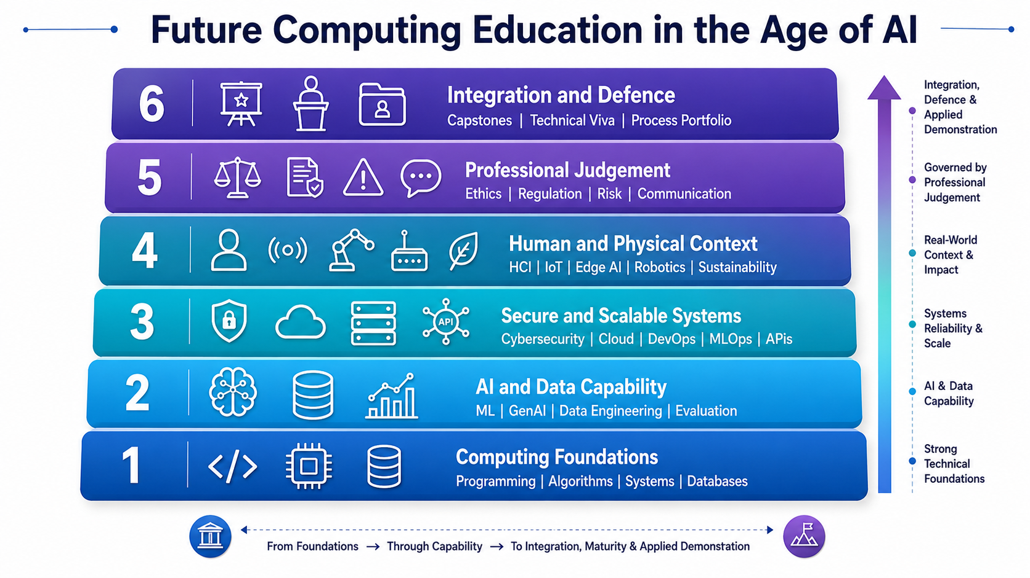
The AI Native Computing Education Stack
The solution is not to add one AI module
The curriculum must become AI native, security aware, and systems oriented
Students should repeatedly integrate foundations, AI, data, cloud, security, and judgement
Fig 4: A hierarchical framework for Future Computing Education in the Age of AI, illustrating the progression from technical foundations to professional judgment and applied integration. (Generated from Gemini/ChatGPT
Notes:
My proposed solution is an AI native computing education stack. The aim is not to remove fundamentals or simply add a generative AI module. The aim is to connect foundations with AI, data, security, systems, human context, and professional judgement.

Slide 17
Keep the Fundamentals, Change the Evidence
Students still need programming, algorithms, databases, networks, and systems
But final output alone is weaker evidence than before
We need evidence of reasoning, debugging, testing, and technical decisions
Fundamentals should be assessed through application and defence
Old evidence | New evidence
Final code | Code walkthrough
Final report | Process portfolio
Correct answer | Reasoning path
Submitted model | Evaluation and failure analysis
Working output | Verification and defence
Notes:
I am not arguing that fundamentals are less important. Actually, they are more important. But we need better evidence that students understand them. A final answer, a final report, or a piece of code is no longer enough.

Slide 18
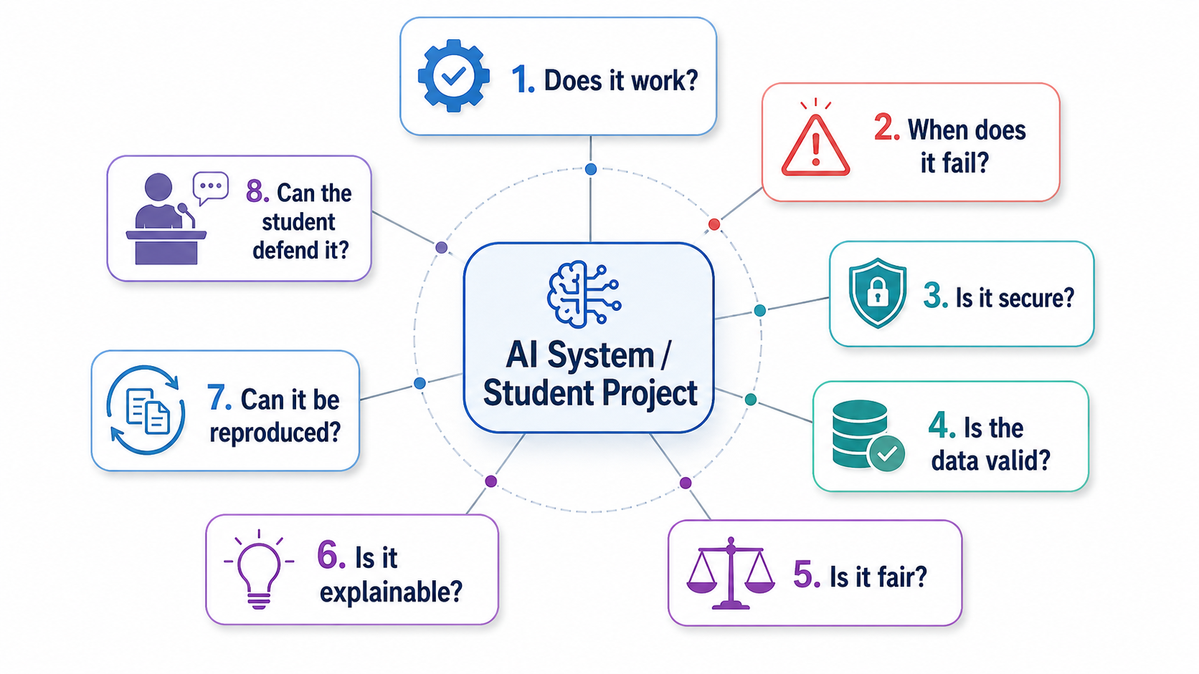
Assess Verification, Not Just Generation
Fig 6: Critical evaluation framework for AI systems and student projects, highlighting the need to assess functionality, failure modes, security, data validity, fairness, explainability, reproducibility, and student defence. (Generated from Gemini/ChatGPT
Notes:
In the AI age, generating an answer is becoming easier. Verifying that answer is becoming more important. This is where human technical judgement becomes central.

Slide 19
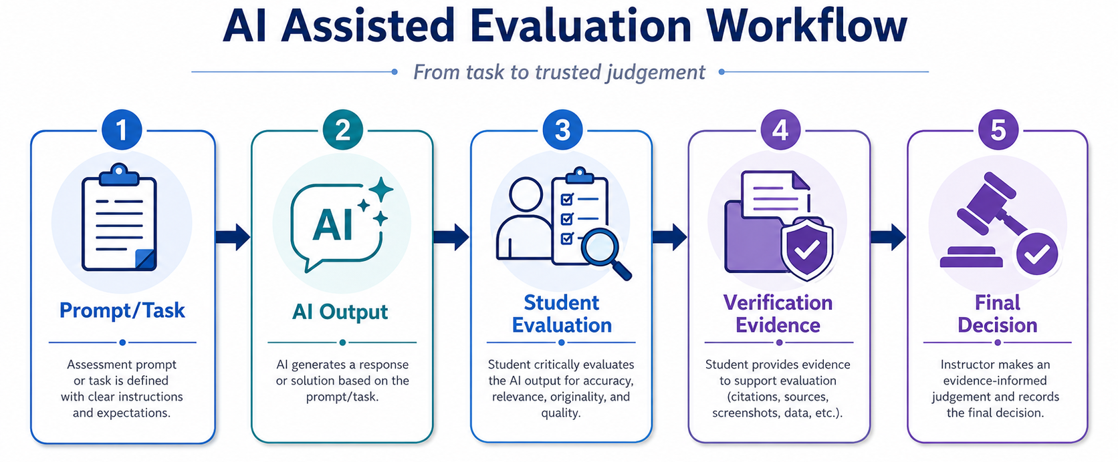
Making AI Use Visible and Assessable
Fig 7: AI assisted evaluation workflow showing how a task moves from prompt definition and AI output to student evaluation, verification evidence, and final evidence informed judgement. (Generated from Gemini/ChatGPT
Notes:
The goal is not surveillance. The goal is intellectual ownership. If students use AI, they should be able to explain how they used it, what they rejected, what they verified, and what decision they finally made.

Slide 20
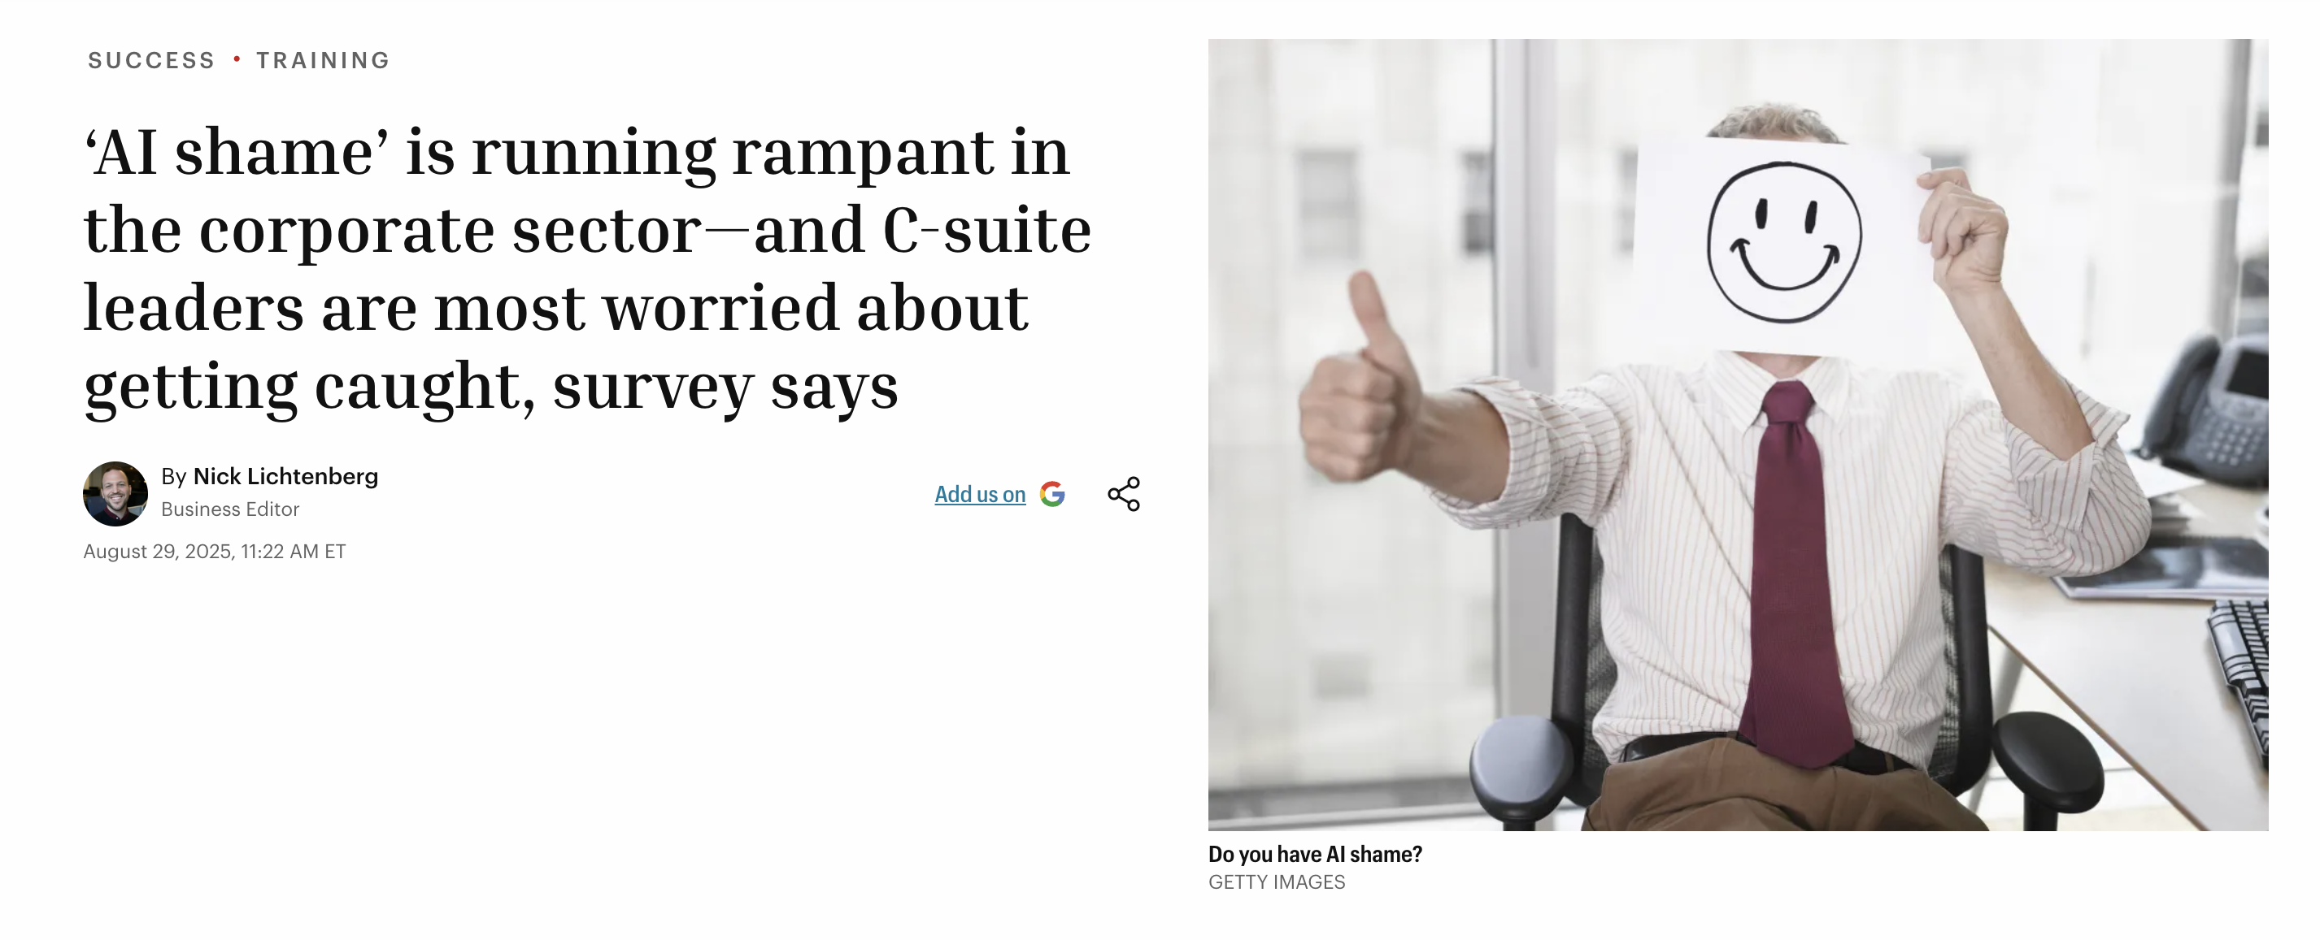
From AI Shame to AI Literacy
A new survey reveals a striking “AI readiness gap” in the modern workplace: Those using AI tools the most—including top executives and Gen Z employees—are often the least likely to receive meaningful guidance, training, or even company approval for their use. (The findings come from WalkMe, an SAP company, which surveyed over 1,000 U.S. workers for the 2025 edition of its AI in the Workplace survey. )
Notes:
Visibility will only work if students feel safe enough to disclose AI use. If disclosure feels like confession, they will hide it. If disclosure becomes part of learning, they will develop judgement.

Slide 21
AI Can Produce Output, But Not Education
AI can produce | Education must form
Code | Judgement
Reports | Understanding
Summaries | Responsibility
Arguments | Intellectual ownership
Answers | The ability to defend them

Slide 22
From Horse Carriage Pedagogy to Computing Judgement
The road has changed
The tools have changed
The labour market has changed
Computing itself has changed
Curriculum and assessment must now change
The future of computing education is not less technical. It is more deeply technical, more human, and more judgement based.

Slide 23


Get in Touch

